Slide 1
NSTAR ISS Demo Documentation (updated 14MAR24)
Alec Engl

Slide 2
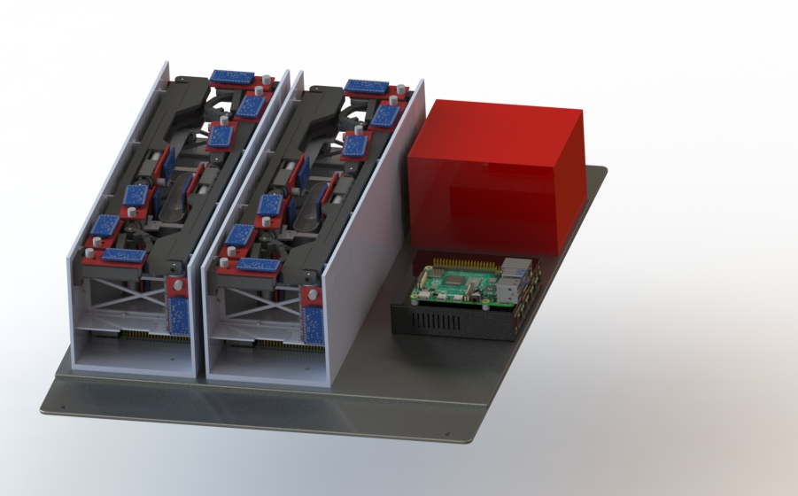

Slide 3
Basic definitions
Pose:
Combined position and orientation
i.e. pose completely defines the 6DOF of a rigid body
Forward kinematics:
Input: motor angles
Output: robot gripper (end effector) pose
Inverse kinematics:
Input: (desired) robot gripper (end effector) pose
Output: (all possible) motor angle combinations

Slide 4
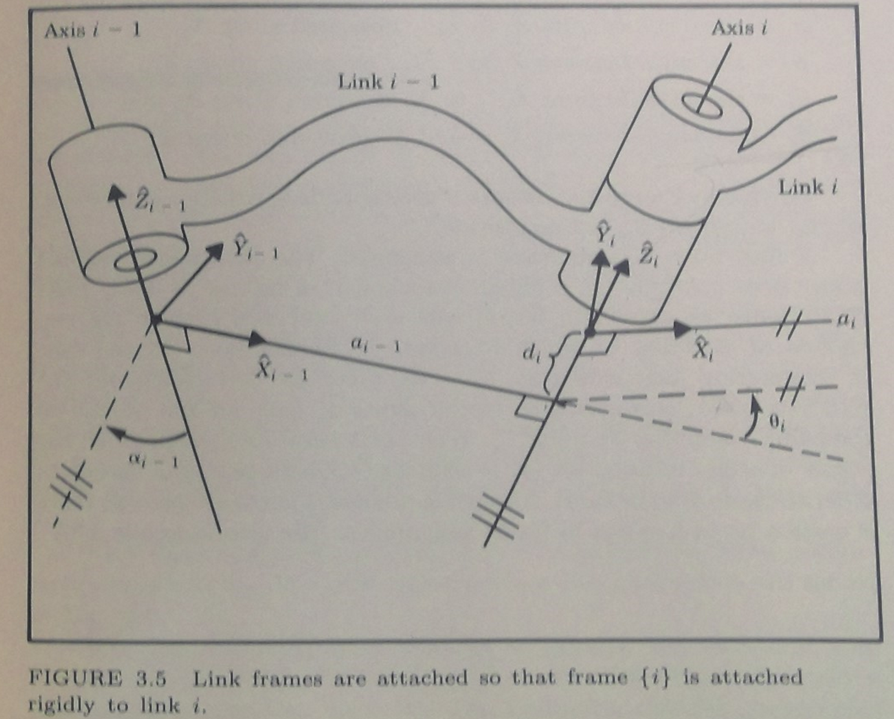
Basic Definitions, cont
Denavit-Hartenberg (DH) parameters
Set of 4 parameters that describe the connection of sequential links in a serial manipulator chain (robot arm)
Comes in standard or modified formalisms, we will use the ‘modified’ version
See figure 3.5, ref: Craig 2ed

Slide 5
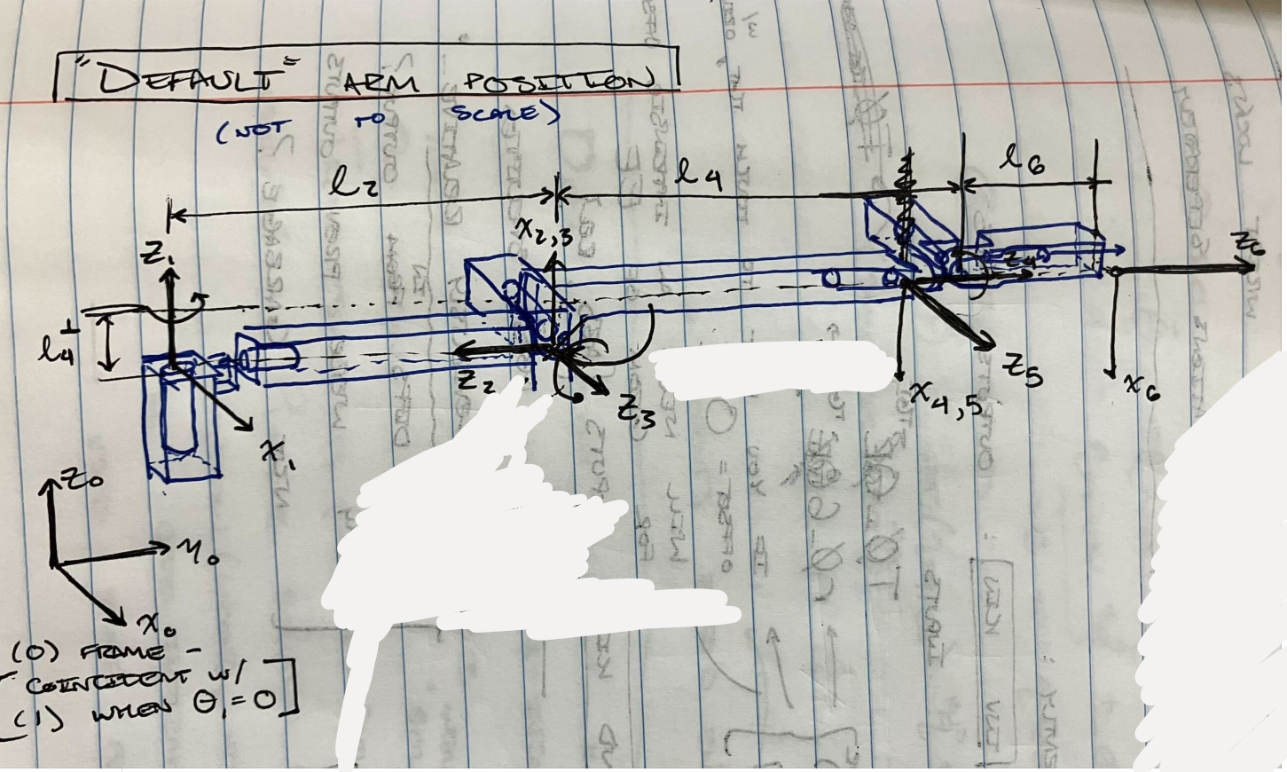
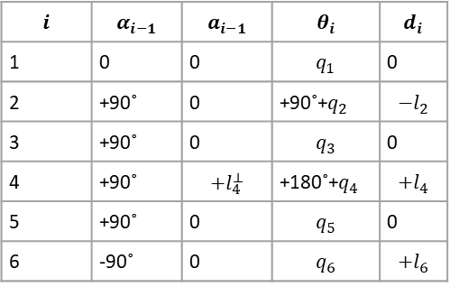
Modelling our arm (modified DH parameters)
$$i$$ | $$α_{i−1}$$ | $$a_{i−1}$$ | $$θ_{i}$$ | $$d_{i}$$
1 | 0 | 0 | $$q_{1}$$ | 0
2 | +90˚ | 0 | +90˚+$q_{2}$ | $${−l}_{2}$$
3 | +90˚ | 0 | $$q_{3}$$ | 0
4 | +90˚ | $$+l_{4}^{⊥}$$ | +180˚+$q_{4}$ | $${+l}_{4}$$
5 | +90˚ | 0 | $$q_{5}$$ | 0
6 | -90˚ | 0 | $$q_{6}$$ | $${+l}_{6}$$

Slide 6
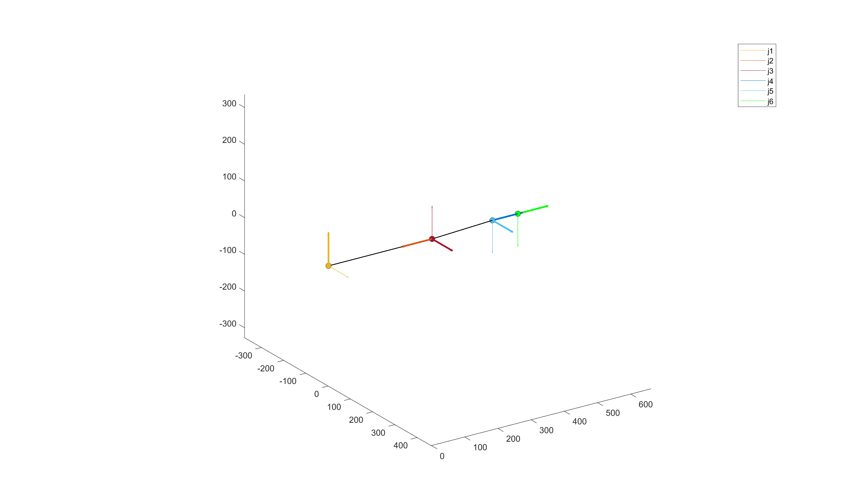
Modelling our arm, cont
Note that only the x and z axes are plotted, and the z axis is bolded

Slide 7
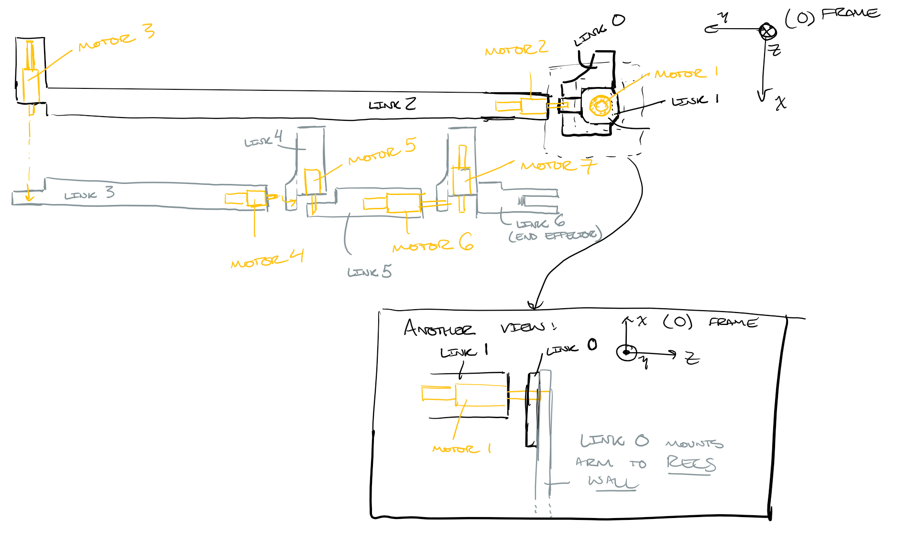

Distinguishing motor angles from $θ$
Consider arm as a serial chain of “links” connected by joints
We will number them from root to tip/end effector (as in the above figure)

Slide 8
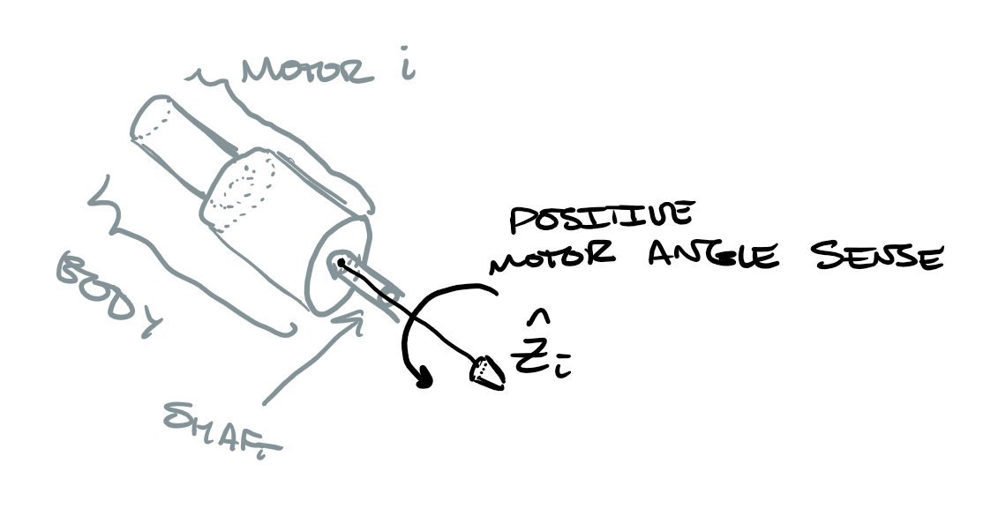

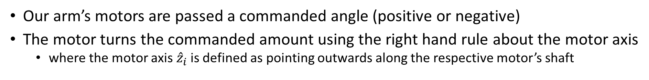
Distinguishing motor angles from $θ$, cont
Our arm’s motors are passed a commanded angle (positive or negative)
The motor turns the commanded amount using the right hand rule about the motor axis
where the motor axis ${\hat{z}}_{i}$ is defined as pointing outwards along the respective motor’s shaft

Slide 9
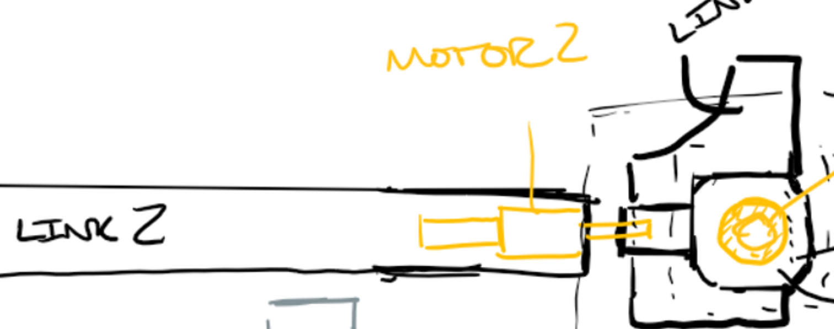
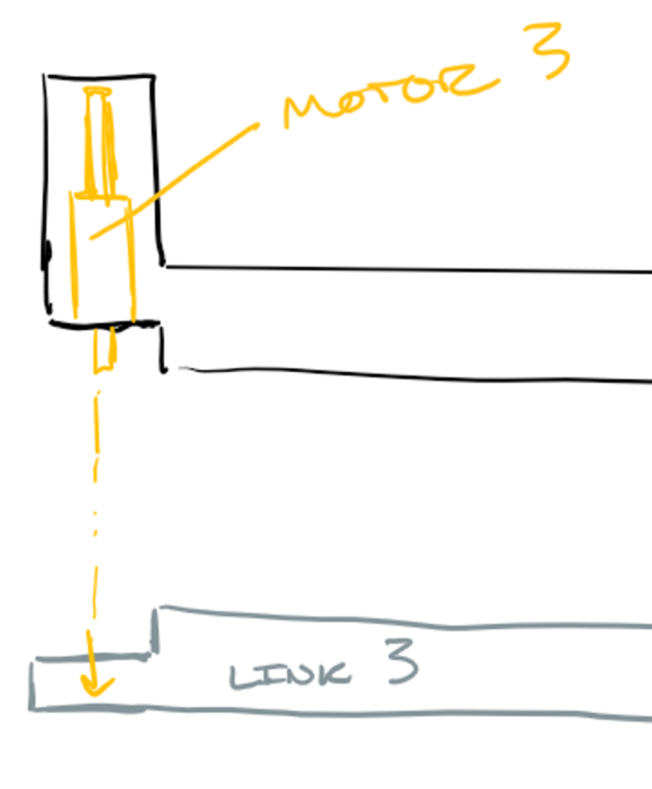
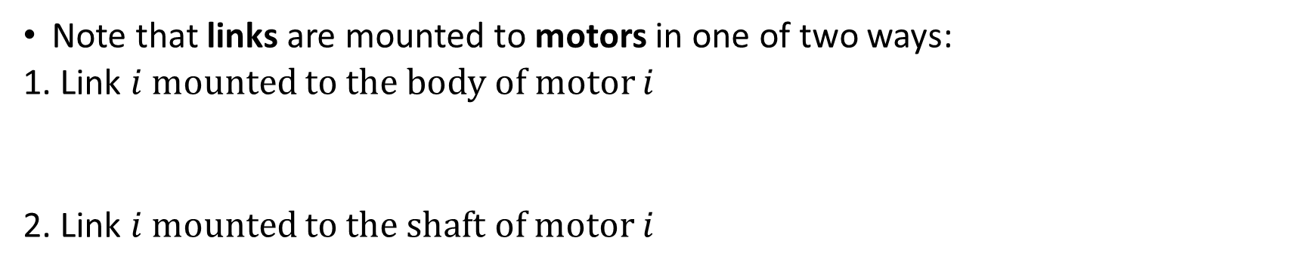

Distinguishing motor angles from $θ$, cont
Note that links are mounted to motors in one of two ways:
1. Link $i$ mounted to the body of motor $i$
2. Link $i$ mounted to the shaft of motor $i$

Slide 10
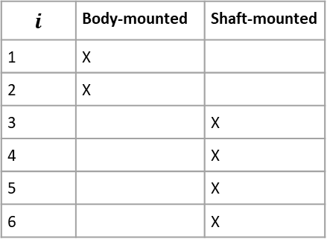

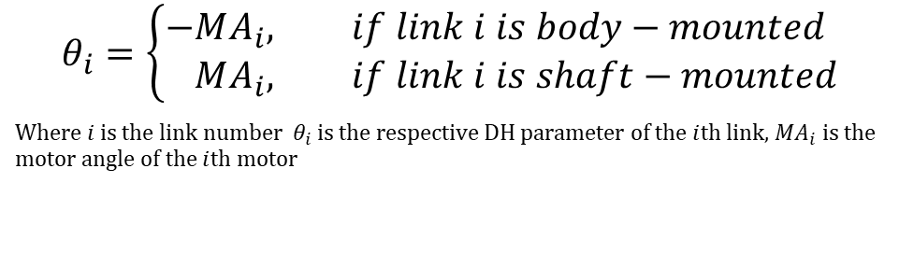
Distinguishing motor angles from $θ$, cont
Thus we must distinguish these two cases so that the modelled arm moves in the same way as the physical arm based on a commanded motor angle:
$$θ_{i}=\left\{\begin{aligned}−&MA_{i}, if link i is body−mounted \\ &MA_{i}, if link i is shaft−mounted\end{aligned}\right.$$
Where $i$ is the link number $θ_{i}$ is the respective DH parameter of the $i$th link, ${MA}_{i}$ is the motor angle of the $i$th motor
$$i$$ | Body-mounted | Shaft-mounted
1 | X
2 | X
3 |  | X
4 |  | X
5 |  | X
6 |  | X

Slide 11
…in code
% MOUNTING PARAMS
% Relating motor command sense to kinematic sense based on mounting
% mountMult(i) = +1 => segment (i) is mounted on motor shaft
% mountMult(i) = -1 => segment (i) is mounted on motor body
obj.mountMult = [-1 -1 1 1 1 1]’;
Functionality is contained in theta = motorAngle2theta(obj,motorAngles)

Slide 12
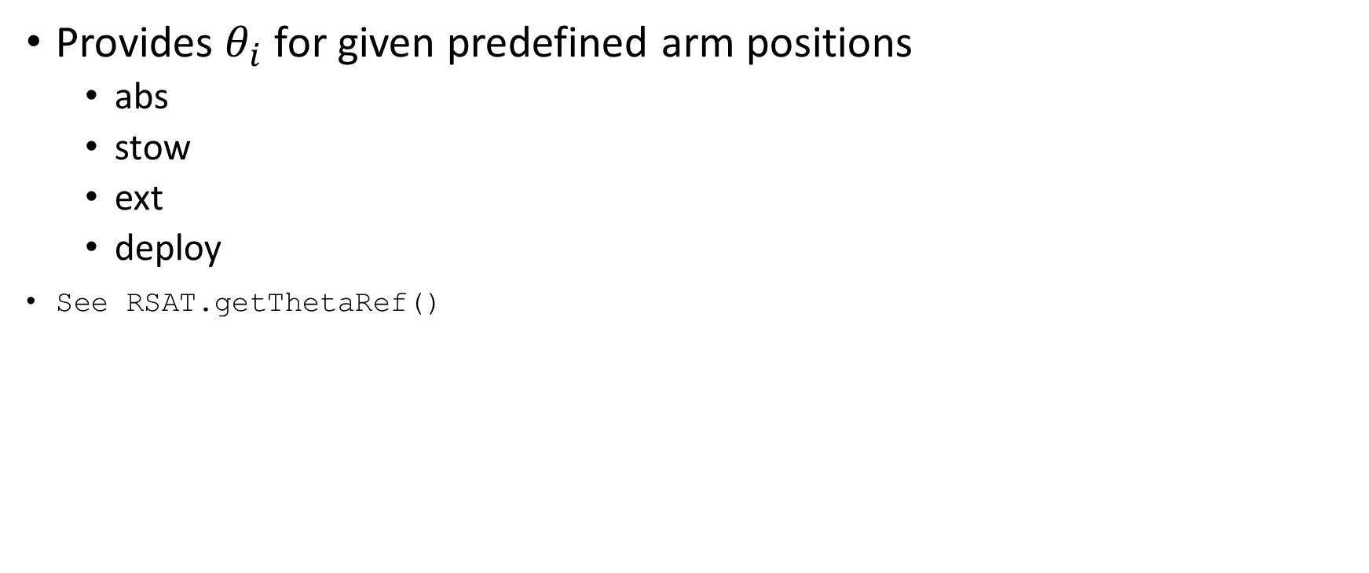
Preset arm positions
Provides $θ_{i}$ for given predefined arm positions
abs
stow
ext
deploy
See RSAT.getThetaRef()

Slide 13
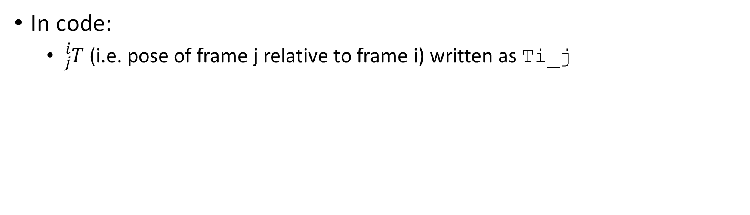
Pose formalism: the homogenous transform
In code:
${}_{j}^{i}T$ (i.e. pose of frame j relative to frame i) written as Ti_j

Slide 14
Forward kinematics

Slide 15
Inverse kinematics

Slide 16
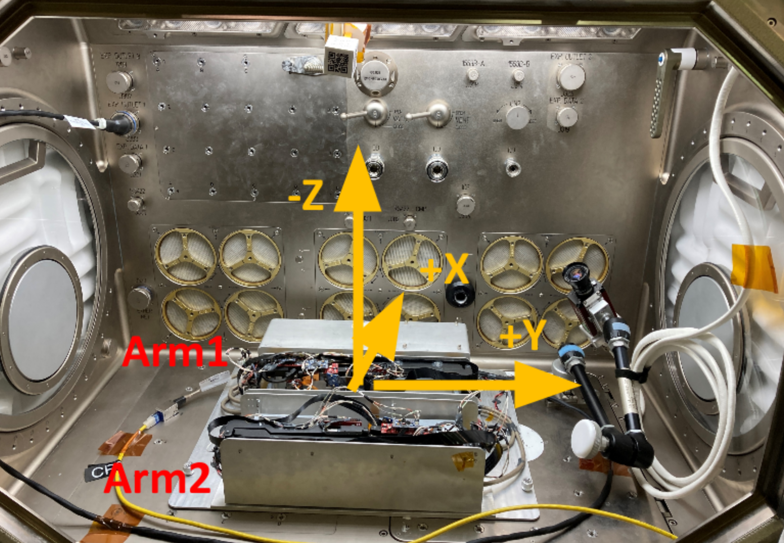
Transferring between reference frames
Naming conventions

Slide 17
Path planning

Slide 18
Google drive
Root folder, titled ‘manual’, contained at the following link:
https://drive.google.com/drive/folders/1guFemfbZfnqu6mfbpTJaoW1zAeX9zzLs?usp=sharing

Slide 19
Organization
General purpose scripts for robotics calculations are contained at the root
Stuff specific to Rsat and our experiment in the MSG contained in /classdef

Slide 20
Classdef
MSG.m
Contains scripts pertaining to the whole experiment in the MSG coordinate frame, or wrappers for RSAT.m functions
RSAT.m
Contains scripts pertaining to a given RECS and its arms in their respective coordinate frames, or wrappers for general robotics functions for our specific use case

Slide 21
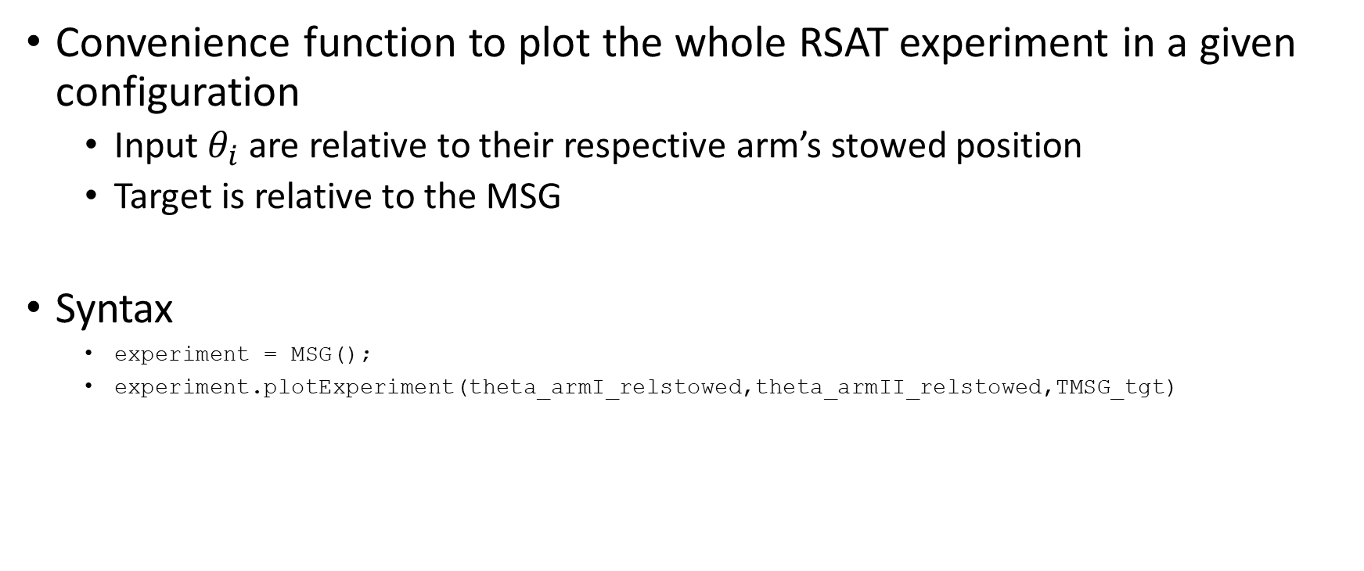
MSG.plotExperiment
Convenience function to plot the whole RSAT experiment in a given configuration
Input $θ_{i}$ are relative to their respective arm’s stowed position
Target is relative to the MSG
Syntax
experiment = MSG();
experiment.plotExperiment(theta_armI_relstowed,theta_armII_relstowed,TMSG_tgt)

Slide 22
RECS.tgtWtask2goal()
List off tasks

Slide 23
MSG.MSGplyGrabPose()
GUI-search for a .ply pointcloud, open&view it, manually select pose points with the MATLAB plot interface, and return pose of a (rectangular) target in the MSG frame
A wrapper for pointclouds/plyGrabPose.m
INPUTS
zmax = maximum depth in pointcloud displayed (in m) (D435 has depth noise out to infinity depth)
(good values: zmax = .55 for ISS 10JAN24, .62 for Houston test)
CANNED: Boolean, =true if want to skip the manual pose determination for a pre-saved scenario (from the Houston test)
OUTPUTS
TMSG_tgt: 4x4 homogenous pose matrix describing the pose of the cube target relative to the MSG reference frame

Slide 24
manualPilot.m
The script /classdef/manualPilot.m does the following:
Queries user for .ply file in file explorer GUI
Displays the selected .ply file (which should contain a good view of one of the cube target’s square faces)
User will use mouse cursor and hover over points of interest on the cube target to determine their coordinates (see slide “Acquiring target, determining pose”)
Once complete, user presses any key in the MATLAB command line
Script computes target pose with respect to the MSG reference frame
If variable CANNED= true, steps 1-3 are skipped and script will draw from a pre-saved target pose
Script queries user for current commanded motor angles to determine arm position (via forward kinematics)
NOTE: User will be prompted with
Input vector of current motor angles of arm II relative to the stowed position:
=> input [0 0 0 0 0 0] if the arm is in the stowed position
Plots the current configuration of robot arm and cube target inside the MSG
Displays displacement vector between end effector and target
NOTE: Refers to the operational arm as ‘arm II’ (see earlier slide)

Slide 25
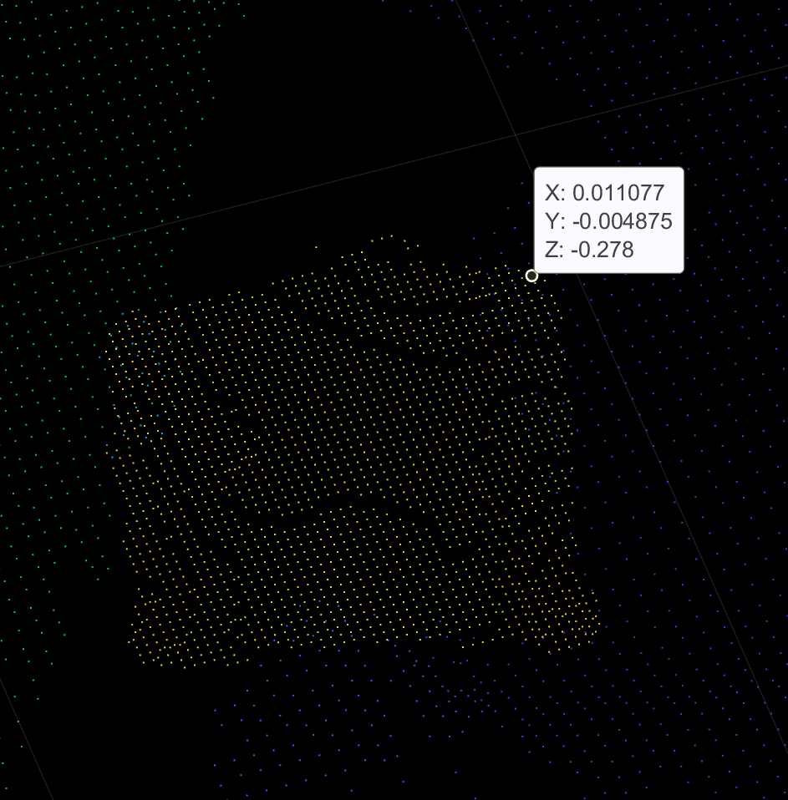
Acquiring target, determining pose
disp("Ensure the following when selecting points:")
disp("1. select p1-4 in a counterclockwise fashion to ensure z axis is the outward normal")
disp("2. select the points to be the vertices of a rectangle if possible (e.g. the visible face of the cube target”)
disp("3. Units are meters/(m) (which are native to the D435 .ply so don't need to change)")
disp("NOTE: p1-3 only are used to compute axes/orientation of target")
disp("p1-4 are averaged to determine centerpoint")

Slide 26
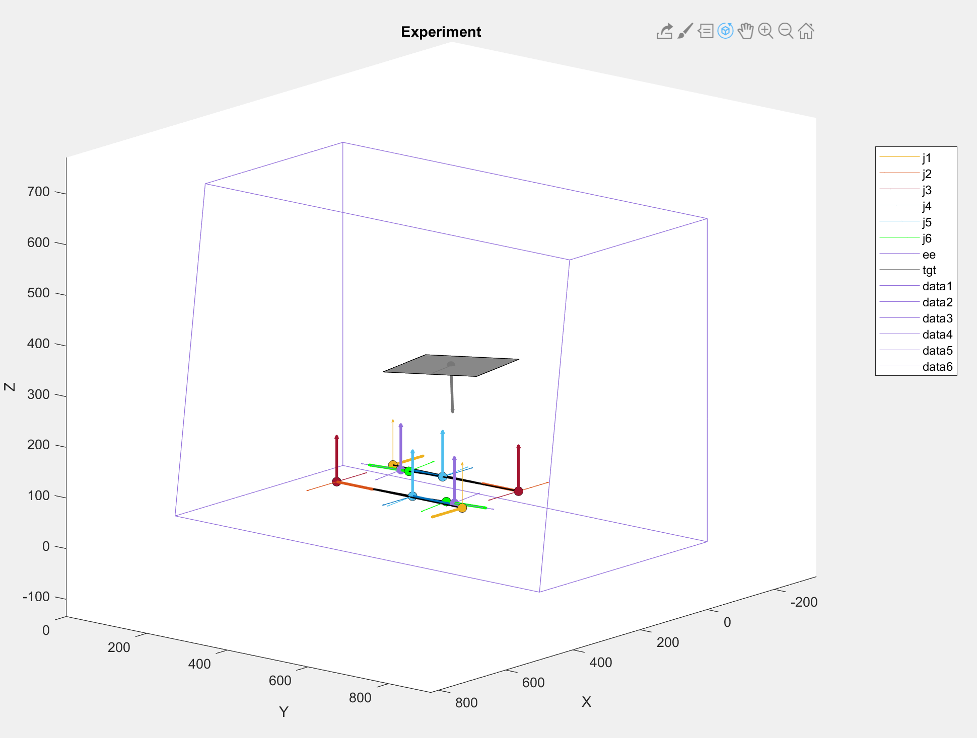
manualPilot.m, cont
Above is the result for CANNED = true, input [0 0 0 0 0 0]

Slide 27
autoPilot.m
While manual piloting can be used to operate the arm into a desired pose, it is desirable to do so more precisely and comprehensively
The script /classdef/autoPilot.m does the following:
Pulls target pose from a pointcloud (.ply)
Determines where the arm end effector should be (MSGtgtWtask2goal)
Must input a given task (e.g. ”move2point”), see the appropriate slide
Analytically solves the inverse kinematics problem to determine all possible motor angle combinations that put the end effector there
NOTE: User will be prompted with
Input vector of current motor angles of arm II relative to the stowed position:
=> input [0 0 0 0 0 0] if the arm is in the stowed position
Plots the viable solutions in the experiment environment
NOTE: Refers to the operational arm as ‘arm II’ (see earlier slide)

Slide 28
What defines a viable inverse kinematics solution?
If an analytical solution does not exist:
Then the arm is not physically capable of reaching the specified target
If a solution does exist, then must pass multiple layers of filtering:
Motor angle limits specific to each arm joint (i.e. “joint limits”)
Based on geometry, wiring, etc
MSG boundaries/environment collision
Collision with other arm (not applicable for us at the moment ☹)

